Slide 1
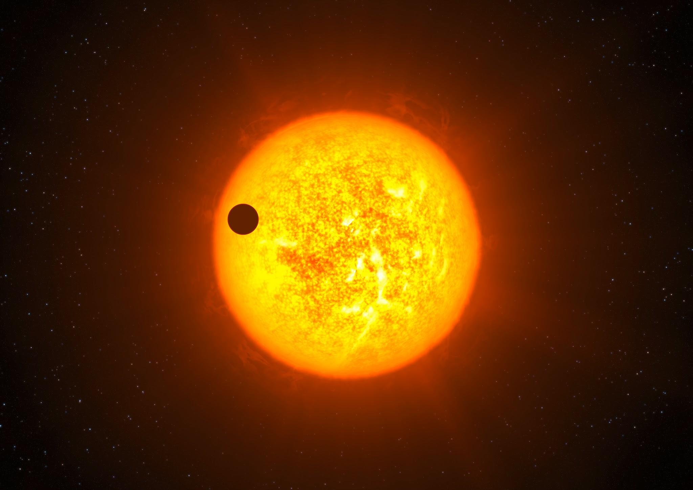
Exploring Exoplanet Detection Techniques
By: Daniel Zurawski, Victor Karkour, and Jake Kamen

Slide 2
Motivation
Explore detection methods
Transits
Radial Velocity
Direct Imaging
Astrometry
Microlensing
Determine pros and cons of these methods (When should we use each?)
Notes:
Explain that the motivation for this projects is to explore these different methods for exoplanet detection and compare them side by side. Go through each of the methods quickly.
“The purpose of this paper is to explore the different detection methods used for finding exoplanets. These methods of detection include Transits, Radial Velocities, Direct Imaging, Astrometry, and finally Microlensing. Each technique merits its own benefits but also contains setbacks due to the properties they observe. Some use the planet’s mass, its distance from its star, or its orbital period to better understand the body. If we can pinpoint which method is better for distinct situations, then we can develop a fuller picture of the night sky, using detection techniques when best applicable. Overall, by better understanding these detection methods as well as each of their setbacks, we can learn more about the pattern of planet formation throughout the universe and our own detection biases.”

Slide 3



Methods
Planetary data set from the NEA website (contains masses, radii, semi-major axis, periods, etc.)
Coding
Equations and tables
Plotting!! (using colab)
Transit:
RV:
Imaging:
Notes:
Just go through each of the methods used and how they contributed to the results.
38000 exoplanets in data set

Slide 4


Methods part 2
Transit method: Measuring the drop in light as planet passes in front of star.
Using Radial Velocity: works by measuring doppler shift of spectral lines as star moves (shared center of mass)
RV sensitivity is based on planet mass and the semi major axis
Direct imaging sensitivity (instrument based)
Limited by diffraction limit of telescope
Diffraction Limit
Small Angle Approximation

Slide 5
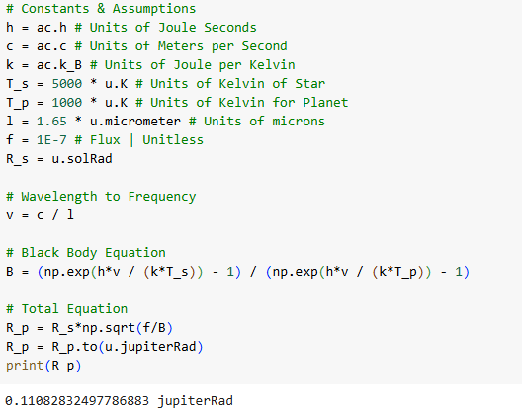
Coding
Some of the code!
Used code to plot via colab
Used this to create the plots coming up shortly

Slide 6
Results
Four key relationships
Mass vs Period
Mass vs Semi-major axis
Radius vs Period
Radius vs Semi-major axis

Slide 7
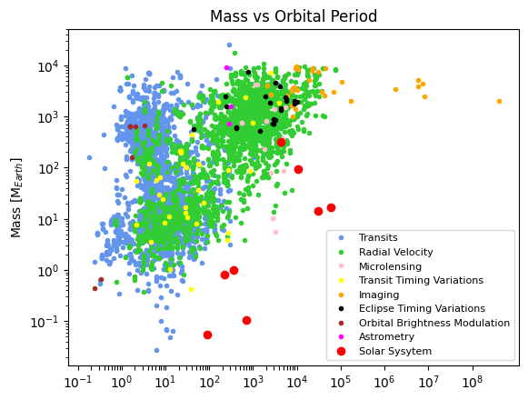
Mass vs Period Plot
Notice red dots for solar system planets
Migration: Some planets beyond snow line can move slowly in towards the host star
Explains the gaps
Notes:
Another explanation is purley selection bias

Slide 8
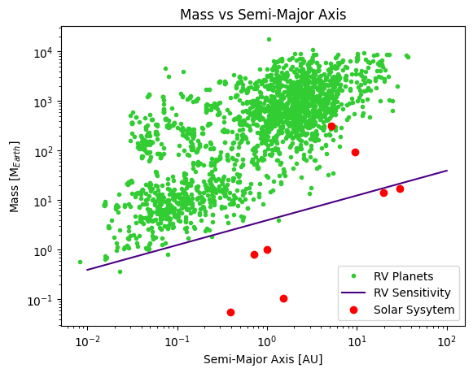
Mass vs Semi-Major Axis Plot
RV sensitivity line
Shows limits of Radial Velocity Detection
Most of our solar system planets sit below the line!

Slide 9
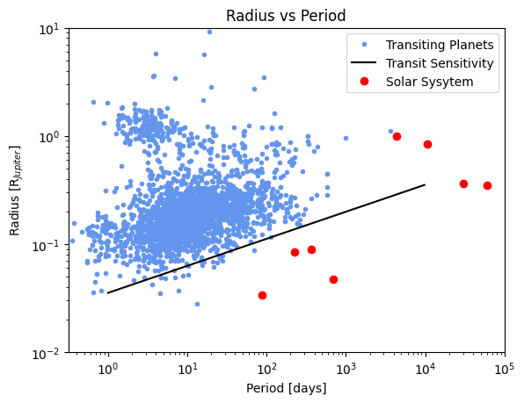
Radius vs Period Plot
Transit sensitivity line
Planets with larger radii have an easy time forming farther away from their parent star

Slide 10
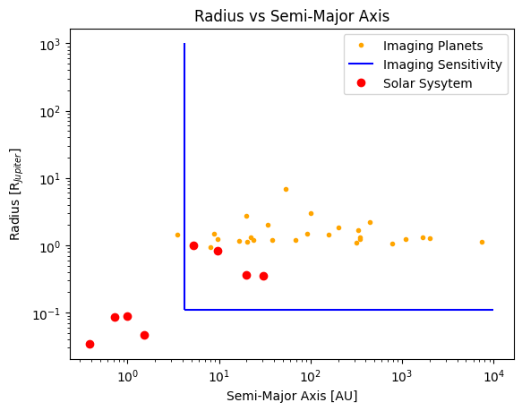
Radius vs Semi-Major Axis Plot
Imaging sensitivity line
Shows sensitivity of Direct imaging method
Minimum orbital separation (vertical line)
Size of objects observing (horizontal line)
Much larger limits than the others.

Slide 11

Conclusion
Motivation completed?
Opinion on the overall project
Yes!

